Slide 1
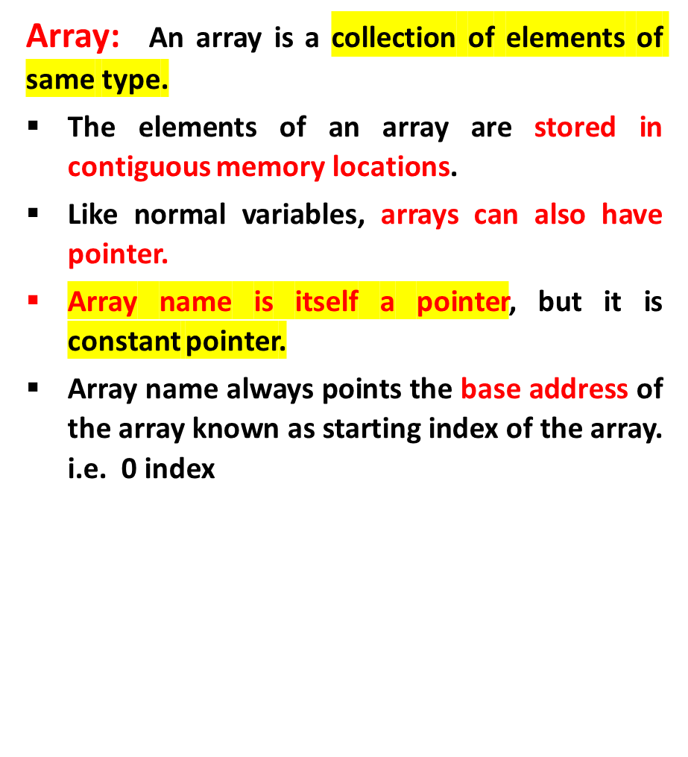
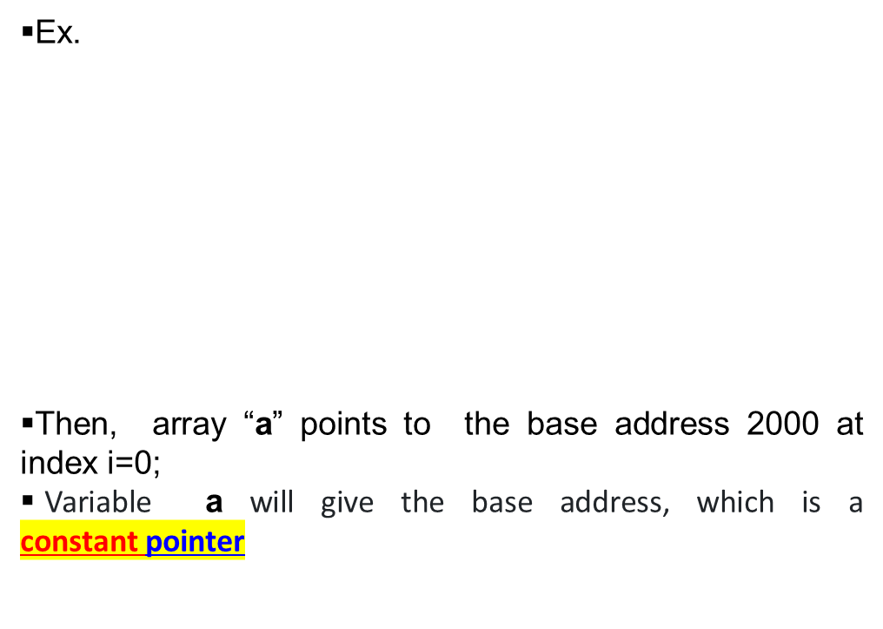
Pointers with Arrays
int a[5] = {10, 20, 30, 40, 50};
index i 0 1 2 3 4
address 2000 2004 2008 2012 2016

Slide 2
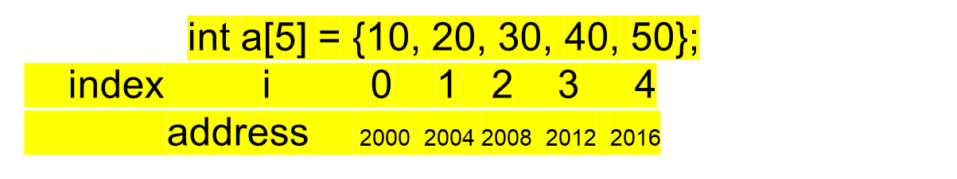
Pointers and Arrays
Accessing the addresses using array names:
a a+1 a+2 a+3 a+4
Array name ‘a’ is a constant pointer. It indicates the base address of the array a[0] address.
i.e &a[0]=(a+0) a[1]=(a+1) ……&a[i]=(a+i) //address of index i
Accessing the values using array addresses:
a[0]===*(a+0) ,a[1]====*(a+1) ….a[i]=====*(a+i) //value at index i

Slide 3
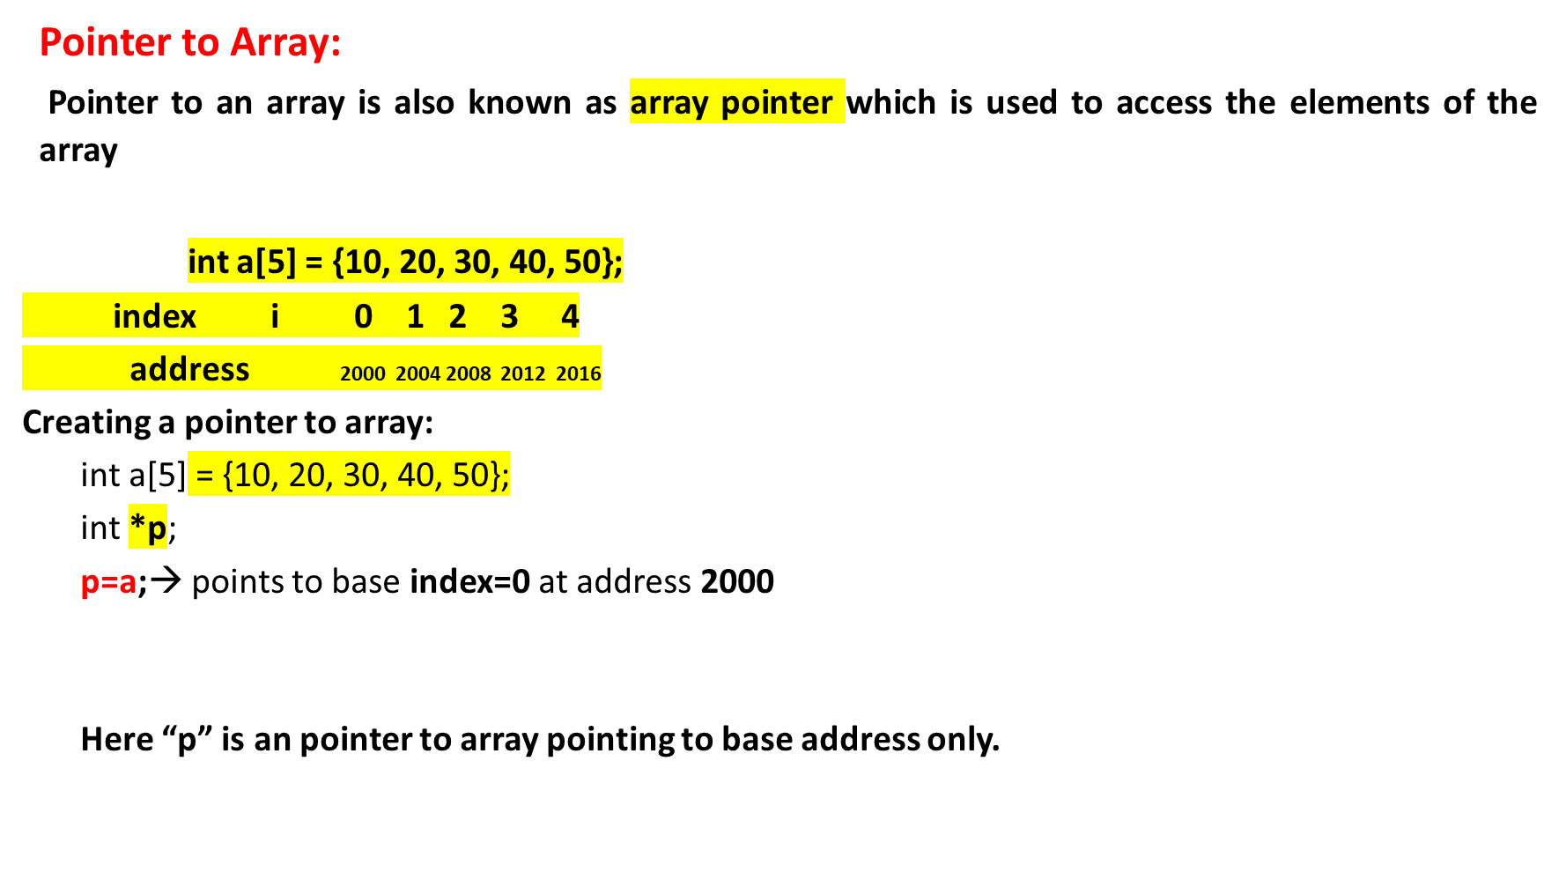
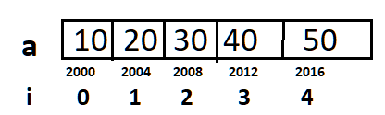
Pointers and Arrays

Slide 4

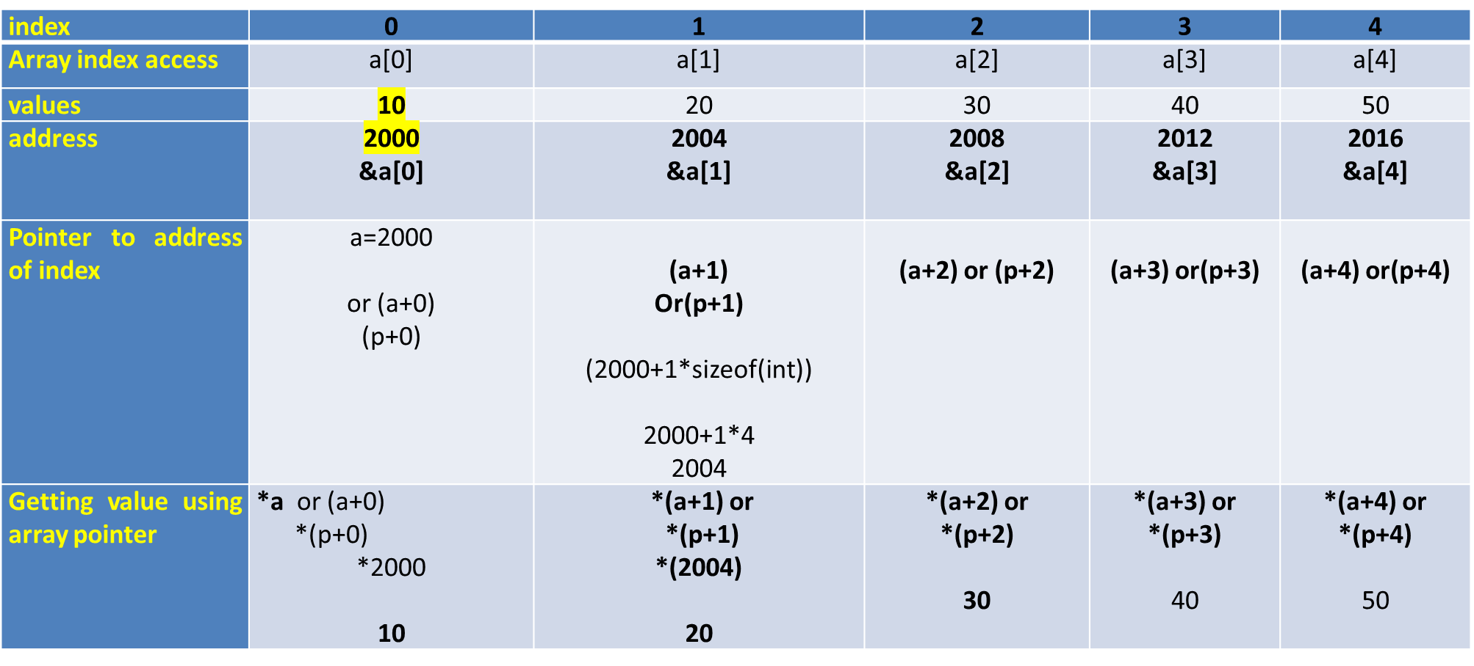
Pointers and Arrays

Slide 5
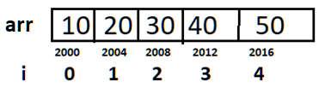
      INPUT:
      int arr[5] = {10,20,30,40,50};
      Output:
      Poiner address is 2000
      Value at pointer is 10
LOGIC:
Create an array.
2. ptr=a;
3. Print ptr //Prints 2000
4. Print *ptr ////Prints 10

Slide 6
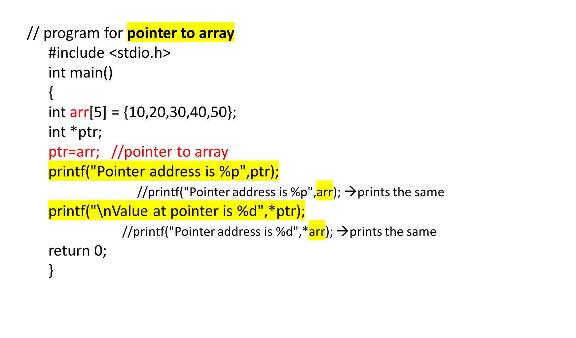
ptr=2000
Prints 2000
Prints 10

Slide 7
  Q) Write a C program for Reading and Printing an array elements using Pointers
Enter the size of array
4
enter array elemnts
10
20
30
40
the array elements are
10
20
30
40
LOGIC:
Create an array a[ ]
2. Create a pointer to the array a *ptr
ptr=a;
3. Read the size of array
4. Read the elements of array using pointer
    for(i=0;i<n;i++)
    scanf("%d",ptr+i);
5. Print the elements of array using pointer
    for(i=0;i<n;i++)
    printf("%d \n",*(ptr+i));

Slide 8
    //C program for Reading and Printing array elements using Pointers
    #include<stdio.h>
    int main()
    {
    int x[20],n;
    int *ptr, i ;
    ptr = x;
    printf("Enter the size of array\n");
    scanf("%d",&n);
    printf("enter array elemnts\n");
    for(i=0;i<n;i++)
    {
    scanf("%d",ptr+i);
    }
    printf("the array elements are\n");
    for(i=0;i<n;i++)
    {
    printf("%d \n",*(ptr+i));
    }
    return 0;
    }

Slide 9
Q). What will be the output of the following C code?
#include <stdio.h>
void main()
{
int a[3] = {1, 2, 3};
int *p = a;
printf("%p\t%p", p, a);
}
a) Same address is printed
b) Different address is printed
c) Compile time error
d) Nothing

Slide 10
Q). What will be the output of the following C code?
#include <stdio.h>
void main()
{
int a[3] = {1, 2, 3};
int *p = a;
printf("%p\t%p", p, a);
}
a) Same address is printed
b) Different address is printed
c) Compile time error
d) Nothing

Slide 11
Q). What will be the output of the following C code?
#include <stdio.h>
int main()
{
int ary[4] = {1, 2, 3, 4};
int *p = ary + 3;
printf("%d\n", p[-2]);
}
a) 1
b) 2
c) Compile time error
d) Some garbage value

Slide 12
Q). What will be the output of the following C code?
#include <stdio.h>
int main()
{
int ary[4] = {1, 2, 3, 4};
int *p = ary + 3;
printf("%d\n", p[-2]);
}
a) 1
b) 2
c) Compile time error
d) Some garbage value
View Answer

Slide 13
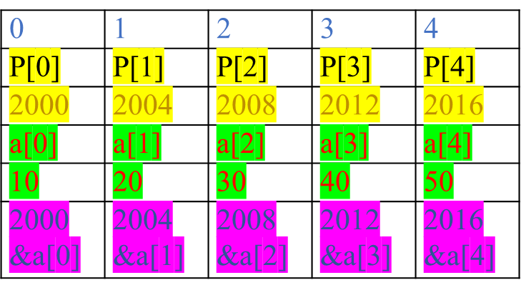
Pointers and Arrays
Array of pointers
Like array of integers, array of characters we can also have array of pointers.
Array pointers can be defined as, collection of pointers/addresses of similar data type variables.
Ex: Array of integer pointers, array of character pointers.
In other words ,collection of pointers of same datatype.
Syntax: Array of pointers
int a[5]; //a is array of 5 integer elements
datatype *arrayname[size];
Example:
int *p[5]; // p is an array of 5 integers pointers or
// p is an array of 5 integer addresses.
p[0]=&a[0], p[1]=&a[1]………………..p[4]=&a[4]

Slide 14
Write a C Program to implement array of pointers.
INPUT:
Enter array size
5
Enter array values:
10
20
30
40
50
output:
Array of pointers
1002 1004 1006 1008
The array elements are
10 20 30 40 50

Slide 15
Program to implement array of pointers
//array of pointers
#include<stdio.h>
int main()
{
int a[10],i,n;
int *p[10];
printf("Enter array size\n");
scanf("%d",&n); //n=5
//reading the array elements
printf("Enter array values\n");
for(i=0;i<n;i++)
{
scanf("%d",&a[i]);
}
//storing the addresses of array elements
for(i=0;i<n;i++)
p[i]=a+i;
//display the addresses
printf("\n the addresses are ..")
for(i=0;i<n;i++)
printf("%u\n",p[i]);
printf("the values at address are\n");
for(i=0;i<n;i++)
printf("%d\n",*p[i]);
return 0;
}

Slide 16
Pointer to Pointer(double pointer):**
*→single pointer(pointer)
** →double pointer(pointer to pointer)
A pointer to pointer holds the address of pointer of same type is known as pointer-to-pointer or double pointer.
Declaration of a Pointer to Pointer
Syantax: datatype **ptrtoptr;
int **q ;
Here q is a pointer to pointer. There must be two *’s in the declaration of pointer to pointer.
Ex:
int a = 10, *p, **q; //p is pointer, q is pointer to pointer
Initialization of pointer to pointer:
Ptrtoptr_var=&ptr_var;
p = &a; //pointer initialization consider address of a=1000
q=&p ; // Pointer to pointer initialization consider address of p=2000

Slide 17
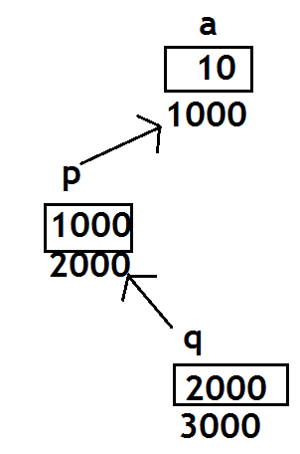
Pointer to Pointer(double pointer):**
Initialization of pointer to pointer:
p = &a; //pointer holds1000
q=&p ; // Pointer to pointer initialization
//holds 2000
q=&a; // invalid a is not pointer
a=10, p=1000, q=2000
Accessing value of pointer to pointer:
*p=10 *q=1000 , *a=error
The value at double pointer can be accessed as.
**q
i.e **q→*(*q)→*(p)→a=10
(p is a pointer)
(q is a Double pointer)

Slide 18
Q) Write a C program to create a pointer to pointer(double pointer)
INPUT:
Enter a
789
OUTPUT:
Value of a = 789
Value of a using single pointer = 789
Value of a using double pointer = 789

Slide 19
Pointer to Pointer(double pointer):**
// C program to create a pointer to pointer(double pointer)
#include <stdio.h>
int main()
{
int a , *p, **q;
printf(“Enter a\n”);
scanf(“%d”,&a);
p = &a; //initializing pointer
q = &p; //initializing ptr to ptr
printf("Value of a= %d\n", a );
printf("Value of a using single pointer = %d\n", *p);
printf("Value of a using pointer to pointer = %d\n", **q);
return 0;
}

Slide 20
Parameter passing mechanism: Call by Reference
The call by reference method of passing arguments to a function copies the address of an argument into the formal parameter.
Inside the function, the address is used to access the actual argument used in the call.
It means the changes made to the parameter affect the passed argument.
Ex>
swap(&a, &b); //&a and &b are address or references
void swap(int *x, int *y)
{
int temp;
temp = *x; // save the value of x
*x = *y; // put y into x
*y = temp; // put temp into y
return;
}

Slide 21
Difference between call by value and call by reference
Call by value | Call by reference
In call by value the function parameters are variable names | In call by reference the function parameters are address of the variable names
Here parameters are normal variables | Parameters are pointers
The values of actual parameters are assigned to formal parameters | The address actual parameters are assigned to formal parameters
There is a separate memory for both actual and formal parameters. Memory can not be shared. | There is no separate memory for both actual and formal parameters. Memory is shared.
The changes in formal parameters will not reflect to actual parameters. | The changes in formal parameters will reflect to actual parameters.
We can only one value with return statement in call by value. | With out return statement. we can return more than value.

Slide 22
Q) Write a C program to swap two numbers using call by reference
    INPUT:
    Enter a, b values
    10 20
    Before swap
    a=10 b=20
    After swap
    a=20 b=10
    LOGIC:
    1.Read a,b values
    2. Display a,b before swapping.
    3.Call swap(&a,&b) function using call by reference
4. In swap() do the following int t;
t=*x;
*x=*y;
*y=t;
    5.Display the values of a,b after swaping

Slide 23
//c program to swap two numbers using call by reference
  void swap(int *,int*);
  int main()
  {
  int a,b;
  printf(“Enter a,b values\n”);
  scanf(“%d%d”,&a,&b);
  printf(“Before swap\n”);
  printf(“a=%d b=%d\n”,a,b);
  swap(&a,&b);
  printf(“After swap\n”);
  printf(“a=%d b=%d\n”,a,b);
  return 0:
  }
  void swap(int * x,int *y)
  {
  int t;
  t=*x;
  *x=*y;
  *y=t;
  }
Output:
Before swap
A=10 b=20
After swap
A=20 b=10

